Slide 1
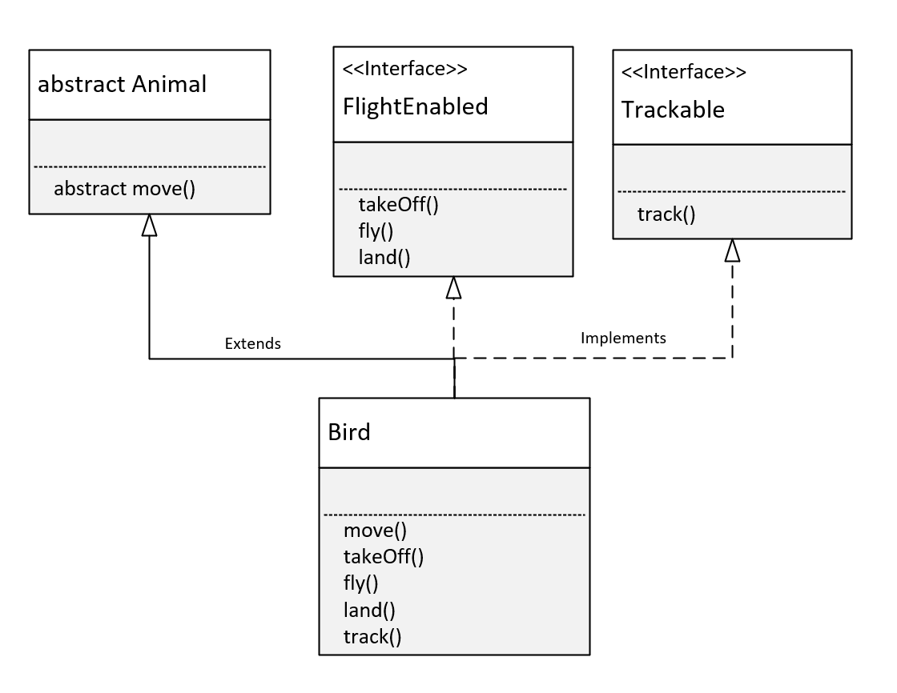

The Bird Class
An interface lets us treat an instance of a single class as many different types.
The Bird Class inherits behavior and attributes from Animal, because we used the extends keyword in the declaration of Bird.
Because the move method was abstract on Animal, Bird was required to implement it.
The Bird Class implements the FlightEnabled interface.
This required the Bird class to implement the takeOff, fly, and land methods, the abstract methods on FlightEnabled.
COMPLETE JAVA MASTERCLASS
Interfaces Part 2

Slide 2
The Bird Class
The Bird Class also implements the Trackable interface.
This required the Bird class to implement the track method, which was the abstract method declared on Trackable.
Because of these declarations, any instance of the Bird class can be treated as a Bird.
This means it has access to all of bird's methods, including all those from Animal, FlightEnabled, and Trackable.
An instance of Bird can be treated like, or declared as an Animal, with access to the Animal functionality, described in that class, but customized to Bird.
COMPLETE JAVA MASTERCLASS
Interfaces Part 2

Slide 3
The Bird Class
It can be used as a FlightEnabled type, with just the methods a FlightEnabled type needs, but again customized for the Bird.
Or it can take the form of a Trackable object, and be tracked, with specifics for the Bird class.
COMPLETE JAVA MASTERCLASS
Interfaces Part 2

Slide 4
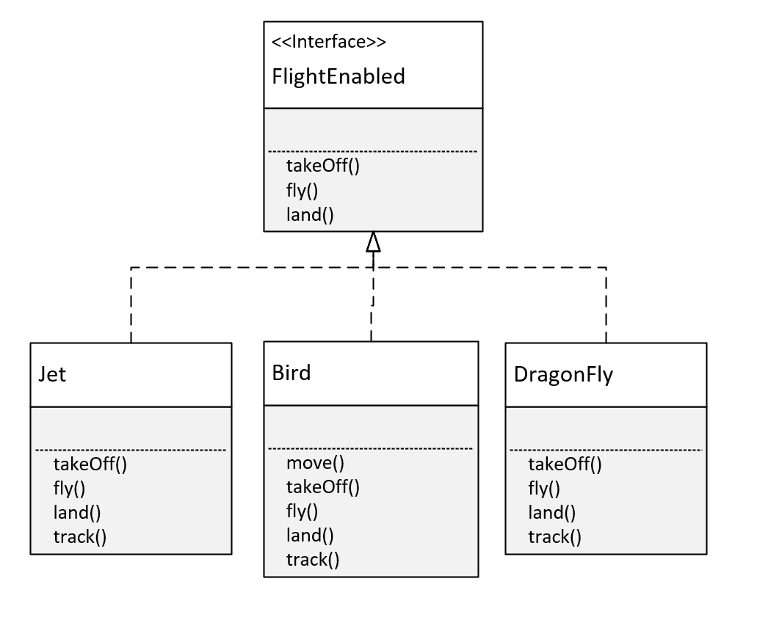
The FlightEnabled Interface
Interfaces let us take objects, that may have almost nothing in common, and write reusable code, so we can process them all in a like manner.
On this slide, you can see that a Jet, a Bird, and a DragonFly, are very different entities.
But because they implement FlightEnabled, we can treat them all as the same type, as something that flies, and ignore the differences in the classes.
Interfaces allow us to type our objects differently, by behavior only.
COMPLETE JAVA MASTERCLASS
Interfaces Part 2

Slide 5
The final modifier in Java
When we use the final modifier, we prevent any further modifications to that component.
a final method means it can't be overridden by a subclass.
a final field means an object's field can't be reassigned or given a different value, after its initialization.
a final static field is a class field that can't be reassigned, or given a different value, after the class's initialization process.
a final class can't be overridden, meaning no class can use it, in the extends clause.
COMPLETE JAVA MASTERCLASS
Interfaces Part 2

Slide 6
The final modifier in Java
a final variable, in a block of code, means that once it's assigned a value, any remaining code in the block can't change it.
a final method parameter means, we can't assign a different value to that parameter in the method code block.
The final static field, is what you're really creating, when you declare a field on an interface.
COMPLETE JAVA MASTERCLASS
Interfaces Part 2

Slide 7
Constants in Java
A constant in Java is a variable that can't be changed.
A constant variable is a final variable of primitive type, or type String, that is initialized with a constant expression .
Constants in Java, are usually named with all uppercase letters, and with underscores between words.
A static constant means we access it via the type name.
We saw this with the INTEGER.MAX_VALUE, and the INTEGER.MIN_VALUE fields.
COMPLETE JAVA MASTERCLASS
Interfaces Part 2

Slide 8
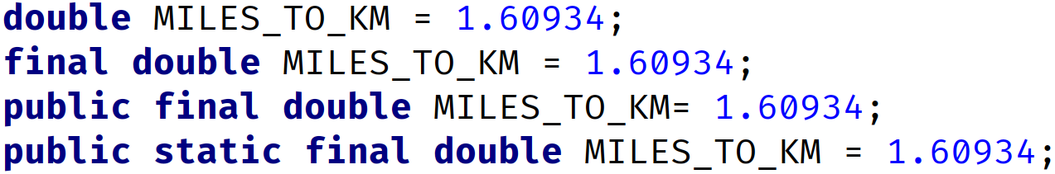
A field declared on an Interface is always public, static and final
Java let's us specify these like an ordinary field on an interface, which might be kind of confusing, and misleading to a new Java programmer.
But we can declare them with any combination of those modifiers, or none at all, with the same result.
These all mean the same thing on an interface.
COMPLETE JAVA MASTERCLASS
Interfaces Part 2

